Slide 1
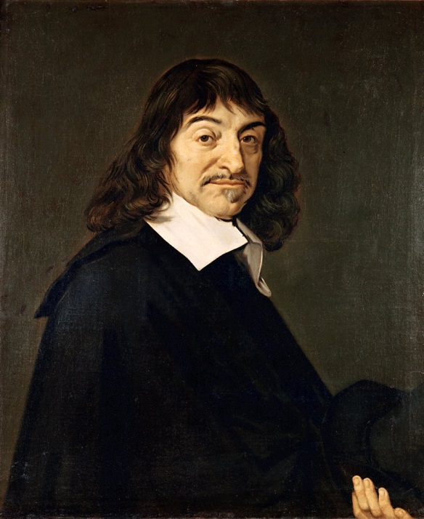
René Descartes
I think, therefore, I am!
Done By:
Aysha Jamal Ali | 20124431
Rawan Yousif Alsabt | 20121453
Latifa Yousif Alqahtan | 20112108
Shaikha Nabeel Alshurooqi | 20121629
Year 3 - Section 4
2014 - 2015

Slide 2
Outline
Introduction
His education and jobs.
Contributions
Philosophy
Mathematics
“Rule of signs” technique

Slide 3
Introduction
Date of birth: March 31st, 1596
Place of birth: La Haye France
Religion: Catholic
Died: February 11th , 1650

Slide 4
His Education and Jobs
His Education and Jobs
In 1606, at ten years old, hew was sent to Jesuit college of La Flèche and studied until 1614.
In 1606, at ten years old, hew was sent to Jesuit college of La Flèche and studied until 1614.
In 1615, He entered the University of Poitiers, and in 1616 he he received his Baccalaureate and License in Canon & Civil Law.
In 1615, He entered the University of Poitiers, and in 1616 he he received his Baccalaureate and License in Canon & Civil Law.
In 1618, he started working to the army of Prince Maurice of Nassau as “Corps of Engineers”. He applied his mathematics to structures machines aimed to protect and assist soldiers in battle.
In 1618, he started working to the army of Prince Maurice of Nassau as “Corps of Engineers”. He applied his mathematics to structures machines aimed at protecting and assisting soldiers in battle.

Slide 5
Contributions
Philosophy
He was Known as
“Father of Modern Philosophy”
Some of his books in Philosophy:
Meditations on first philosophy (1641)
Principles of philosophy (1644)

Slide 6
Famous Quotes:
“It is not enough to have a good mind; the main thing is to use it well.”
“Doubt is the origin of wisdom”

Slide 7
Mathematics
Cartesian Coordinates.
“Rule of signs” technique
Problem solving for geometrical calculus.
Understand the connection between curves construction and its algebraic equation.

Slide 8
B. Mathematics
Re-discovered Thabit ibn Qurra's general
formula for amicable numbers:
Amicable pair 9,363,584 and 9,437,056
(which had also been discovered by another Islamic mathematician, Yazdi,
almost a century earlier).

Slide 9
“Rule of signs” technique
“Rule of signs” technique is used to find the possible positive and negative roots (zeros) for Polynomial without solving or drawing it.
Example1: Finding the positive zeros :
1. Arrange the terms of the polynomial in descending order of exponents.
F(x) = -2x+1
2.Count the number of sign changes.
1
3. There is one sign changes in the polynomial, so the possible number of positive roots of the polynomial is 1

Slide 10
“Rule of signs” technique
Example1: Finding the negative zeros :
1. Arrange the terms of the polynomial in descending order of exponents.
F(-x) = -2(-x)+1
F(-x) = 2x+1
No sign change
2.Count the number of sign changes.
3. There is no change in signs, therefore there is no possible negative zeros.

Slide 11
“Rule of signs” technique
Example1: Finding the positive zeros :
1. Arrange the terms of the polynomial in descending order of exponents.
F(x) = -2x² + 5x - 3
2.Count the number of sign changes.
1
2
3. There are 2 sign changes in the polynomial, so the possible number of positive roots of the polynomial is 2

Slide 12
“Rule of signs” technique
Example1: Finding the positive zeros :
1. Arrange the terms of the polynomial in descending order of exponents.
2.Count the number of sign changes.
1
2
3
3. There are 3 sign changes in the polynomial, so the possible number of positive roots of the polynomial is 3 or 1
It is less than the 3 by an even integer (3 – 2)=0

Slide 13
“Rule of signs” technique
Example 2: Finding the negative zeros :
1. Arrange the terms of the polynomial in descending order of exponents.
No sign change
2.Count the number of sign changes.
3. There is no change in signs, therefore there is no possible negative zeros.

Slide 14
“Rule of signs” technique
Exercise: Find the possible positive and negative zeros in
the Polynomial.
F(X) = x3 + 3 x2 – x – x4– 2
F(X) = x3– x2– 14 x + 24

Slide 15
References :
http://www.storyofmathematics.com/17th_descartes.html
http://images.sharefaith.com/images/3/1261081190693_77/slide-52.jpg
http://upload.wikimedia.org/wikipedia/commons/7/73/Frans_Hals_-_Portret_van_Ren%C3%A9_Descartes.jpg
http://www.crossreferenced.org/wp-content/uploads/2013/02/vintagebkg.jpg
http://plato.stanford.edu/entries/descartes-works/#Med
http://www.goodreads.com/author/quotes/36556.Ren_Descartes
http://hotmath.com/hotmath_help/topics/descartes-rule-of-signs.html

