Slide 1
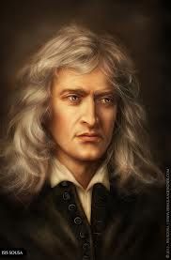
Newton
DONE BY
20122762 | Amani Abdulla
20124809 | Fatima Sayed Yaseen
20124549 | Sayed Hussain S. Mahdi
20121798 | Zainab Mahmood
Section 4
TC2MA324

Slide 2
Isaac Newton
1643 – 1727 , in England.
Physicist, mathematician, and the greatest scientist of his era.
His school reports described him as 'idle' and 'inattentive'.
He formulated Three Laws of Motion, and the Universal Gravitation law.
He contributed in optics (the refraction of light)

Slide 3
Contributions in Mathematics
“He studied the power series,
generalized the binomial theorem to non-integer exponents,
developed Newton’s method for approximating the roots of a function
shared credit with Gottfried Leibniz for the development of calculus.” (Williams, M. 2014)

Slide 4
Derivative
f (x) = c x
f(x) = c x^{n}
n
n
’
⁻¹
n
q (a) = 9 a
q (a) = 9 a⁴
Example:
4
4
⁻¹
’
( )
= 36 a³

Slide 5
العبيكان. 2011 .مملكة البحرين. الرياضيات 5. المشتقة. 149- 156 http://obeikaneducation.com/obeikanmodules/ebooks/view_book/333/95
Derivative
f prime of x
f(x) = | f’(x)= | Example
x^{n} | n x^{n-1} | f(x) = x⁹  f′(x) = 9x ^{9 – 1} 
cx^{n} | cnx^{n-1} | q(a) = 9a⁴  q’(a) = 9(4)a⁴⁻¹ = 36 a³
cx | c | j(x) = 9x = 9x¹  j’(x) = 9(1) x¹⁻¹ = 9x⁰ = 9
c | 0 | k(x) = 9 = 9x⁰  k’(x) = 9(0) x⁰⁻¹ = 0
x | 1 | g(x) = x = x¹  g’(x) = 1x¹⁻¹ = x⁰ = 1

Slide 6
Derivatives of Trigonometric Functions
العبيكان. 2012 .مملكة البحرين. الرياضيات 6. المشتقة. 32
http://obeikaneducation.com/obeikanmodules/ebooks/view_book/331/95

Slide 7
Calculus
Newton used mathematics to help him to improve his physics work
Newton and Leibniz worked separately on calculus concepts
Newton work through physics Leibniz work through concepts and theory
Both of them said to be the inventors of calculus

Slide 8
Calculus - differentiation
Differentiation measures the amount of change of quantity if another quantity change.
for example: in every 5 seconds you pass 1 meter then , $y=5x$
we will find that the first Derivative will be 5 which is speed y =5x , $f^{′}\left(x\right)=5$ or 5 m/s
the second Derivative will be our acceleration which is zero $f^{′′}\left(x\right)=0$

Slide 9
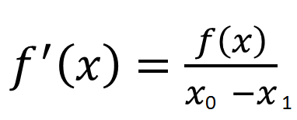
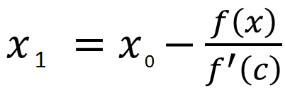
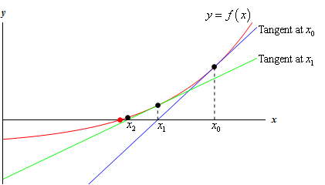
Newton method - proof
If , then
With repeating

Slide 10
Newton Raphson Method - Example
Use Newton’s method to find accurate solution for the following equation:
$$f\left(x\right)= x^{2}−x−1$$
for
$$x_{0}=1.5$$
Write the equation
Write the derivative
Find x₀
Write the formula
Find x₁
$f\left(x\right)=x^{2}−x−1$
$f^{′}\left(x\right)=2 x−1$
$x_{0}=1.5$
$x_{n+1}=x_{n}− \frac{f\left(x_{n}\right)}{f^{′}\left(x_{n}\right)}$
$x_{1}=x_{0}− \frac{f\left(x_{0}\right)}{f^{′}\left(x_{0}\right)}$ =$1.5−\frac{{(1.5)}^{2}−\left(1.5\right)−1}{2 \left(1.5\right)−1}$ = 1.625

Slide 11
Newton Raphson Method – Cont’d
Use Newton’s method to find accurate solution for the following equation:
$$f\left(x\right)= x^{2}−x−1$$
for
$$x_{0}=1.5$$
$x_{n+1}=x_{n}− \frac{f\left(x_{n}\right)}{f^{′}\left(x_{n}\right)}$
$x_{1}=$ = 1.625
$x_{2}\text{=} 1.625 − \frac{{\left(1.625\right)}^{2}−\left(1.625\right)−1}{2 \left(1.625\right)−1}=1.61805$
$x_{3}=1.61803$
Write the formula
Find x₁
Find next x_{n+1}

Slide 12
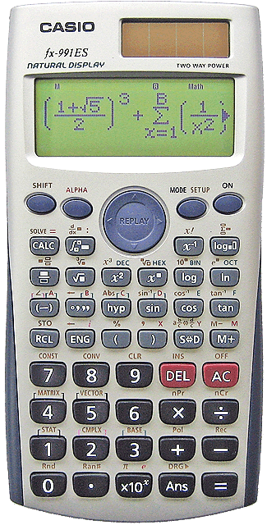
Newton Method in Calculator
$$Ans−\frac{{\left(Ans\right)}^{2}−\left(Ans\right)−1}{2 \left(Ans\right)−1}$$
$$1.5$$
Use Newton’s method to find accurate solution for the following equation:
1.61805
$$1.5$$
1.625
$$f\left(x\right)= x^{2}−x−1$$
for
$$x_{0}=1.5$$
Write the $x_{0}$ value (1.5) then press (=) , then press (AC)
Write the formula, but instead of ($x_{0}$) press (Ans)
After that, press (=), then the answer:
$$x_{1 }=1.625$$
Then, Only press (=) again to find next x value, so next $x →x_{2}=1.61805$
$$x_{1 }= x_{0}−\frac{{\left( x_{0} \right)}^{2}−\left({ x}_{0} \right)−1}{2 \left({ x}_{0 }\right)−1}$$
$$Ans$$
$$Ans$$
$$Ans$$
$$Ans$$

Slide 13
Exercise
Use Newton’s method to find accurate solution for the following equation:
$$f\left(x\right)= x^{3}−2x+1$$
for
$$x_{0}=0.6$$
Answer: $x=0.4142$
Use Newton’s method to find accurate solution for the following equation:
$$f\left(x\right)= {(x−2)}^{2}−1$$
for
$$x_{0}=2$$
Answer: $Math Error!$

Slide 14
Exercise – Cont’d
2. Use Newton’s method to find accurate solution for the following equation:
$$f\left(x\right)= {(x−2)}^{2}−1$$
for
$$x_{0}=2$$
Solution:
Zero
Error

Slide 15
References
BBC.( 2014).UK. History. Retrieved from:
http://www.bbc.co.uk/history/historic_figures/newton_isaac.shtml
J J O'Connor and E F Robertson. (2000). History: Sir Isaac Newton. Retrieved from:
http://www-history.mcs.st-and.ac.uk/Biographies/Newton.html
Williams,M.2014.Canada. What Did Isaac Newton Discover?. Retrieved on
March 24th ,2015, From: http://www.universetoday.com/38643/what-did-isaac-newton-discover/
https://www.youtube.com/watch?v=cOmAk82cr9M
Touger, J. (2006). Introductory physics: Building understanding. Hoboken, NJ: Wiley.
Dawkins, P. (2007, August 1). Pauls Online Notes : Calculus I - Newton's Method. Retrieved March 24, 2015, from http://tutorial.math.lamar.edu/Classes/CalcI/NewtonsMethod.aspx

Slide 16
References
No Author, (2013). Sir Isaac Newton. Info Please. Retrieved from: http://www.infoplease.com/encyclopedia/people/newton-sir-isaac.html
http://ar.wikipedia.org/wiki/%D8%B7%D8%B1%D9%8A%D9%82%D8%A9_%D9%86%D9%8A%D9%88%D8%AA%D9%86_%D8%B1%D8%A7%D9%81%D8%B3%D9%88%D9%86_%D9%84%D8%AD%D9%84_%D8%A7%D9%84%D9%85%D8%B9%D8%A7%D8%AF%D9%84%D8%A7%D8%AA_%D8%BA%D9%8A%D8%B1_%D8%A7%D9%84%D8%AE%D8%B7%D9%8A%D8%A9
http://www.youtube.com/watch?v=eNSZHWzuDvs
http://www.youtube.com/watch?v=COssXEW2dw0
http://www.youtube.com/watch?v=yybxBlprzSs
https://www.youtube.com/watch?v=cOmAk82cr9M
Touger, J. (2006). Introductory physics: Building understanding. Hoboken, NJ: Wiley.
العبيكان. 2011 .مملكة البحرين. الرياضيات 5. المشتقة. 149- 156: http://obeikaneducation.com/obeikanmodules/ebooks/view_book/333/95
العبيكان. 2012 .مملكة البحرين. الرياضيات 6. المشتقة. 32
http://obeikaneducation.com/obeikanmodules/ebooks/view_book/331/95

