Slide 1
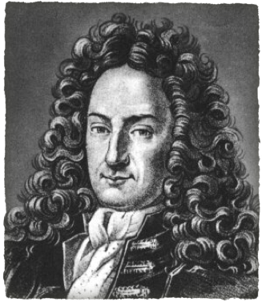
Leibniz (1646-1716)
Done by:
Badreya Mjewan. 20120900
Hala Alabassi. 20123333
Latifa Alsendi. 20112998

Slide 2
Introduction
Name: Gottfried Wilhelm Leibniz
Born: July 1,1646, [Germany]
Died: November 14, 1716
Leibniz does not have a canonical work that stands as his single.

Slide 3
Introduction
He was educated in the Nicolai School but was largely self-taught in the library of his father.
He was:
Philosopher
Mathematician
Political adviser
Metaphysician

Slide 4
Contributions
Discovered the binary number system
Discovery of a new mathematical method called calculus.
Invented the first calculating machine that could add, subtract, multiply and divide.

Slide 5
Leibniz calculating machine

Slide 6
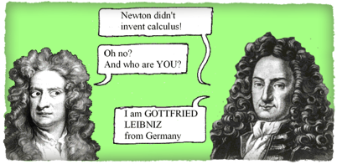
Discovery of a new mathematical method called calculus

Slide 7
Contributions Rule of differentiation
Derivative can be approached in two different ways. One is geometrical (as a slope of a curve) and the other one is physical (as a rate of change). Historically there was (and maybe still is) a fight between mathematicians which of the two illustrates the concept of the derivative best and which one is more useful.

Slide 8
Contributions Rule of differentiation
The furmola of derivative
(f. g)’= (f’. g)+ (f. g’)
Find Y’ if:
Y= X^2 (x+5)
f(x)= x^2 , g(x)= x+5
f’(x)= 2x , g’(x)= 1
y’= + f’(x). g(x) + f(x). g’(x)
y’= 2x. (x+5) + x^2. 1
y’= 2x^2+ 10x + x^2
y’= 3x^2+ 10x

Slide 9
Contributions Rule of differentiation
Try to find the derivative of:
Y= x^4 (2x+ 3)

Slide 10
Importance of derivative
Price Discovery
Risk Management
They Improve Market Efficiency for the Underlying Asset
Help Reduce Market Transaction Costs

Slide 11
References
http://www.computerhistory.org/revolution/calculators/1/49
http://et.m.wikipedia.org/wiki/Gottfried_Wilhelm_Leibniz
http://www.murderousmaths.co.uk/books/calculus/index.htm
http://www.famousscientists.org/gottfried-leibniz/
http://www.iep.utm.edu/leib-met/
http://www.britannica.com/EBchecked/topic/335266/Gottfried-Wilhelm-Leibniz
http://www.famousscientists.org/gottfried-leibniz/
http://www.investopedia.com/exam-guide/cfa-level-1/derivatives/purposes-benefits-derivatives.asp
http://www.sosmath.com/calculus/diff/der00/der00.html

