Slide 1
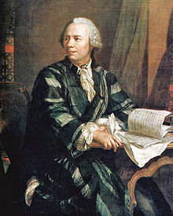
Euler
TC2MA324 - History of Mathematics
Done by:
Mohammed Ahmed 20120023
Noor Taher Hubail 20113636
Zahra Yousif 20113682
Zainab Moh’d Ali 20110932

Slide 2
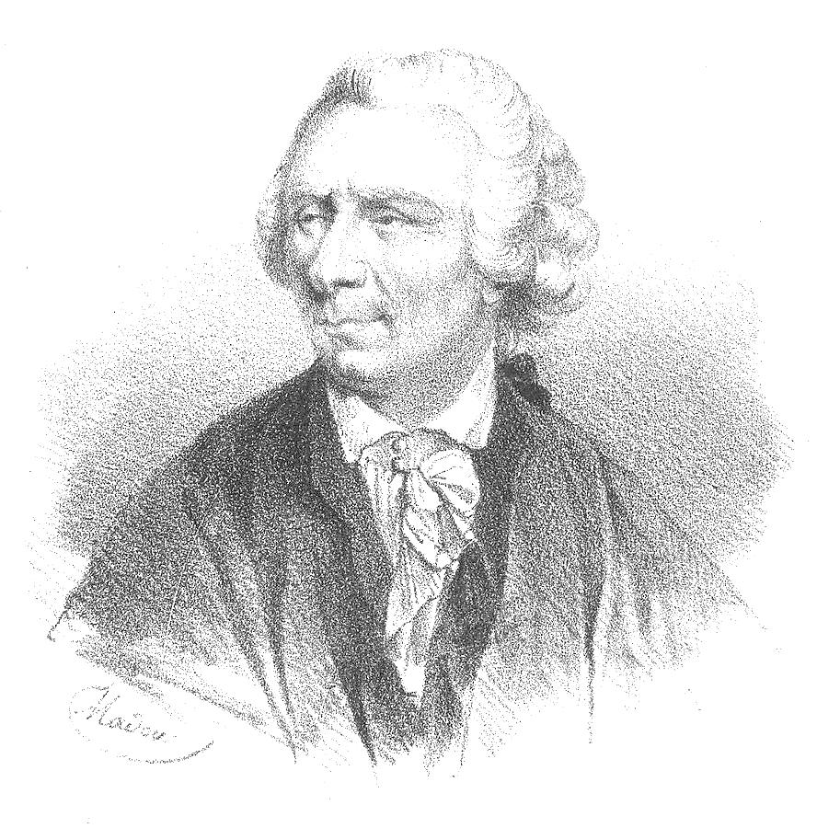
General information
Name: Leonhard Euler
Born: on April 15, 1707, in Basel, Switzerland
Died: September 18, 1783
He Was
One of math's most pioneering thinkers.
Establishing a career as an academy scholar and contributing greatly to the fields of geometry, trigonometry and calculus.
He released hundreds of articles and publications during his lifetime, and continued to publish after losing his sight.

Slide 3
The Contributions
Mathematical notation: Introduced the:
The modern notation for the trigonometric functions,
The Greek letter for summations.
The letter “i” to denote the imaginary unit.
The use of the Greek letter to denote the ratio of a circle's circumference to its diameter.
Analysis:
He is well known in analysis for his frequent use and development of power series, such as
Discovered the power series expansions for e and the inverse tangent function.
Introduced the use of the exponential function and logarithms in analytic proofs.

Slide 4
The Contributions
Number theory: He proved:
Newton's identities
Fermat's little theorem
Fermat's theorem on sums of two squares.
Applied mathematics:
He developed tools that made it easier to apply calculus to physical
problems,
Euler's method and the Euler-Maclaurin formula.

Slide 5
Totient Function: Concepts
Totient Function is defined as “the number of positive integers $≤n$ that are relatively prime to $n$, where 1 is counted as being relatively prime to all numbers” (Wolfarm MathWorld (n.d.). Totient function. Retrieved March 31, 2015, from: http://mathworld.wolfram.com/TotientFunction.html)
Relatively primes are numbers that are “do not contain any factor in common with” (Wolfarm MathWorld (n.d.). Totient function. Retrieved March 31, 2015, from: http://mathworld.wolfram.com/TotientFunction.html)
$φn=\# \{a$│$\gcd{ \left(a, n\right)=1\}}$

Slide 6
Totient Function: Concepts
“The relatively primes of a given number are called totatives” (Wolfarm MathWorld (n.d.). Totient function. Retrieved March 31, 2015, from: http://mathworld.wolfram.com/TotientFunction.html) or coprimes.
Example: totatives (coprimes) of 12 are: (1, 3, 5, 7, 9, 11)
and $φ\left(12\right)=6$
$φ(n)$ is always an even number

Slide 7
Totient Function: Concepts
The difference between $n$ and $φ(n)$ is called cototient.
Example: cototient of $12=12 −φ\left(12\right)$
$=12 −6$
$=6$

Slide 8
Other Names of Totient Function
Euler’s Totient Function
Phi Function
Euler’s Function

Slide 9
Values of $φ(n)$ of some numbers
$$n$$ | $φ(n)$ | numbers coprime (totatives) to n
1 | 1 | 1
2 | 1 | 1
3 | 2 | 1, 2
4 | 2 | 1,3
5 | 4 | 1,2,3,4
6 | 2 | 1,5
7 | 6 | 1,2,3,4,5,6
8 | 4 | 1,3,5,7

Slide 10
Totient Function: Prime Numbers
$2:(1) ⟹$ $φ\left(2\right)= 1$
$3:(1$and$2) ⟹$ $φ\left(3\right)=2$
$5:(1, 2, 3$and$4) ⟹$ $φ\left(5\right)=4$
$7:(1, 2, 3, 4, 5$and$6) ⟹ φ\left(7\right)=6$
$11:(1, 2, 3, 4, 5, 6, 7, 8, 9$and$10) ⟹$ $φ\left(11\right)=10$
Could you come up with a formula for finding the totient function of prime number?
If $P$ is a prime number, then:
$φ\left(P\right)=P−1$

Slide 11
Totient Function: Exponoents
How to find the totient function of $P^{e}$?
First, we will start with $P^{2}:$
$$49÷7=7$$
$7^{2}=49$
$φ\left(49\right)=\left(49−1\right)−\left(7−1\right)=48−6=42$
$∴φ\left(P^{2}\right)=\left(P^{2}−1\right)−\left(P−1\right)=P^{2}−P$

Slide 12
Totient Function: Exponents
Now, we will find $φ(3^{3}):$
$$27÷3=9$$
$φ\left(27\right)=\left(27−1\right)−\left(9−1\right)=26−8=18$
$∴φ\left(P^{3}\right)=\left(P^{3}−1\right)−\left(P^{2}−1\right)=P^{3}−P^{2}$
$φ \left(P^{e}\right)=\left(P^{e}−1\right)−\left(P^{e−1}−1\right)$
$=P^{e}−1−P^{e−1}+1$
$=P^{e}−P^{e−1}$

Slide 13
Proof
We need to prove the theorem:
If $P$ is a prime number, and $e$ is a positive integer, then:
$φ \left(P^{e}\right)=P^{e}−P^{e−1}$
Solution:
Positive integers that are less than $P^{e}$ are: 0, 1, 2, … $P^{e}−1$, but not all these integers are relatively prime to $P^{e}$
So, we need to exclude factor of $P^{e}$

Slide 14
Proof
Con’t:
$∵P$ is a prime number
$∴$ Factors of $P^{e}$ will be multiples of $P$ that are $<P^{e}$ including $P$
So, in each $P$^{th} number, there are $\frac{P^{e}}{P}=P^{e−1}$ factors
Therefore, $φ \left(P^{e}\right)=P^{e}−P^{e−1}$

Slide 15
Totient Function: Multiplicative Property
Theorem: if m and n are relatively primes, then:
$$φ\left(m ∙n\right)=φ\left(m)∙φ(n\right)$$
Example 1:
$φ\left(15\right)=φ\left(5\right)$ $∙$ $φ\left(3\right)$
$=4$ $∙2$
$=8$
Example 2:
$φ\left(165\right)=φ\left(15\right)$ $∙$ $φ\left(11\right)$
$=8$ $∙10$
$=80$

Slide 16
Euler phi function’s examples
When n is a prime number (e.g. 2, 3, 5, 7, 11, 13), φ(n) = n-1.
φ(5) = 5-1= 4
When m and n are coprime, φ(m*n) = φ(m)*φ(n).
φ(15) = φ(5*3) = φ(5)*φ(3) = 4 * 2 = 8
When the phi function with exponent, $φ \left(P^{e}\right)$= $P^{e}−P^{e−1}$
φ(9) = φ(3²), = 3² - 3^1 = 6

Slide 17
Euler phi function’s exercises
Questions
Answers
φ(11)
10
φ(35)
24
φ(4)
2
φ(100)
90
φ(22)
10

Slide 18
Reference:
Euler's Totient Function and Euler's Theorem. Retrieved from: http://www.doc.ic.ac.uk/~mrh/330tutor/ch05s02.html#
Whitman College. 3.8 The Euler Phi Fuction. Retrieved from: http://www.whitman.edu/mathematics/higher_math_online/section03.08.html
Wolfarm MathWorld. Totient function. Retrieved from: http://mathworld.wolfram.com/TotientFunction.html
Lapin, s. ( 2008, march 20 ) Leonhard Paul Euler: his life and his works. Retrieved from http://www.math.wsu.edu/faculty/slapin/research/presentations/Euler.pdf

